Slide 1
Multi-path Inter domain Forwarding (MIFO)
Nithin N M
4NI14MCA29

Slide 2
Abstract
Today’s interdomain routing is traffic agnostic when determining the single, best forwarding path
In this mechanism, where AS border routers adaptively forward outbound traffic from a congested default path to an alternative path, without touching the interdomain routing protocols

Slide 3
A significant challenge facing today’s Internet is the rapid growth of inter domain traffic volume. Daily traffic in large Internet Exchange Points (IXP) is often in tens of petabytes (PB).
There are two fundamentally causes for congestion on the default path between popular ISPs
i. conflict between the rapid growth of traffic load
ii. the mismatch between fast dynamics of traffic and slow route conver-gence

Slide 4
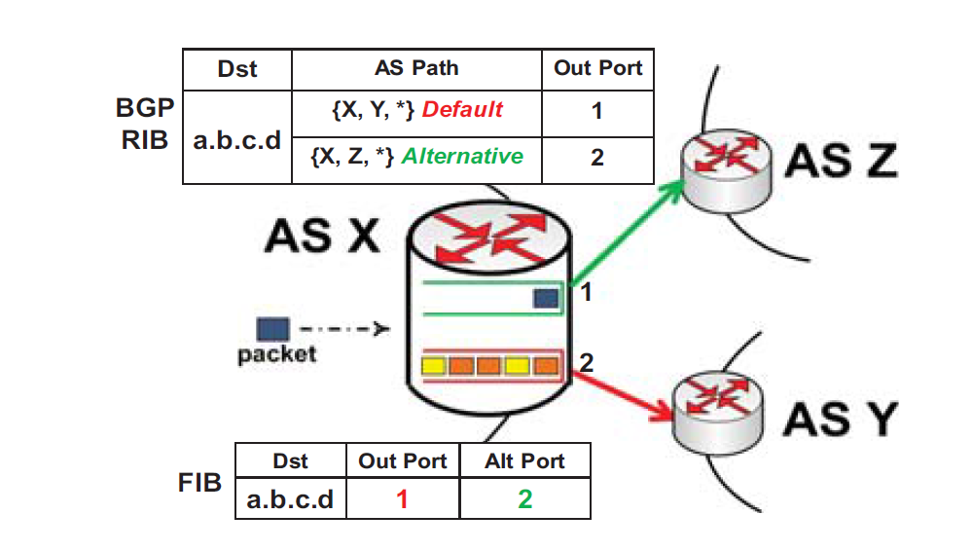

Slide 5
OVERVIEW AND TECHNICAL CHALLENGES
Basic Idea
Design Rationale
Challenges

Slide 6
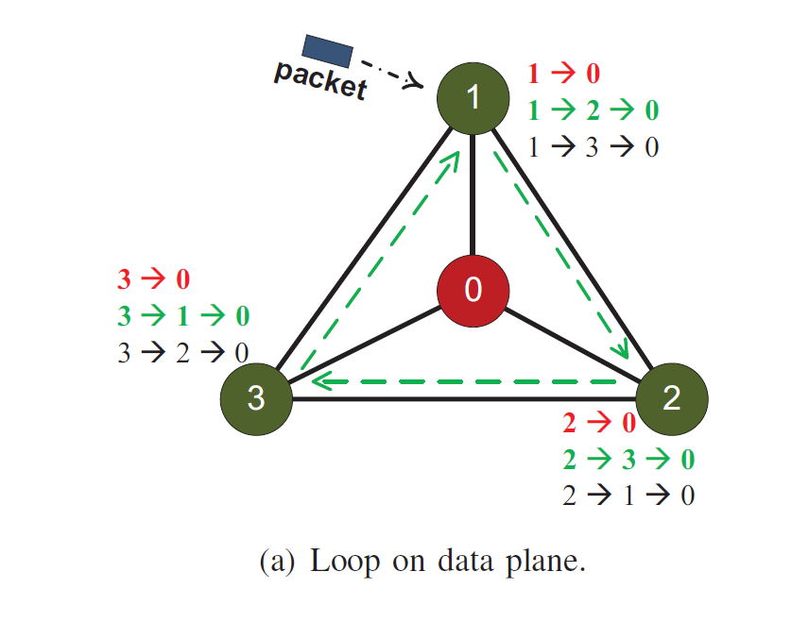
Challenges
Loops on the Data Plane:

Slide 7
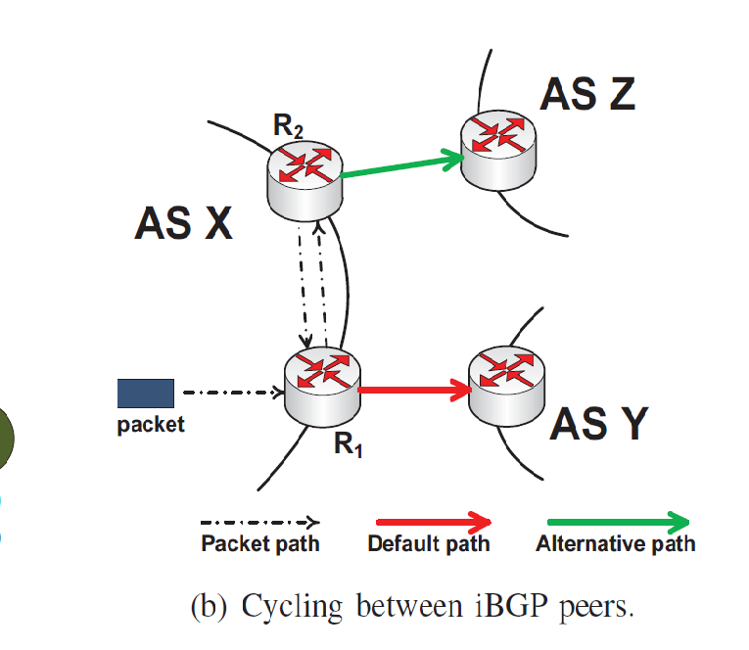
Cycling between iBGP peers

Slide 8
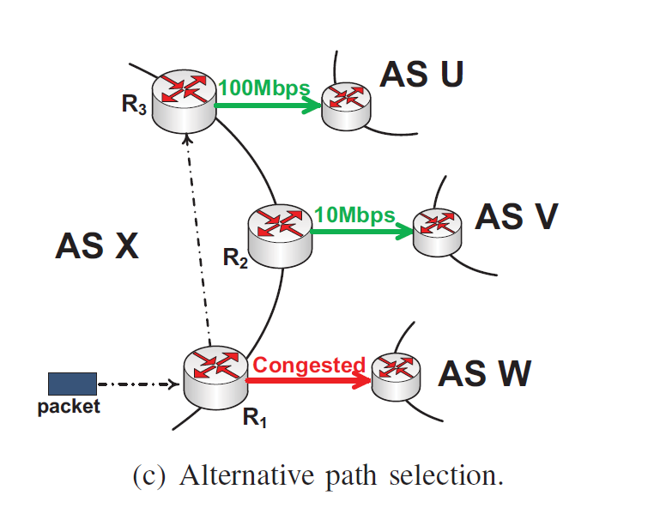
Alternative selection path

Slide 9
MIFO DESIG
Breaking the Loop on Data Plane
The Root Cause of Loop
Main Idea of Loop Breaking
Correctness of the Idea

Slide 10
PERFORMANCE EVALUATION
Path Diversity
Throughput Improvement
Load Balancing
Stability

Slide 11
IMPLEMENTATION BASED EXPERIMENTS
Prototype Implementation
Experiment Setup
Experimental Results

Slide 12
CONCLUSION
It allow the forward packets alternative path instead of congested default path
MIFO avoids loops on the data plane
MIFO provides an efficient greedy method in selecting the best alternative path
MIFO notably improves end-to-end throughput.

Slide 13
THANK
YOU

